Slide 1


Welcome to BOMA
Getting the most out of your membership

Slide 2
Founded In 1907
89 U.S. Associations and BOMA Canada
18 regional associations and BOMA international affiliates.
BOMA membership portfolio:
  10.5 billion square feet of U.S. office space
  1.7 million jobs
  $239.9 billion contribution to the U.S. GDP.
BOMA partners programs offer savings on a wide range of services
BOMA protects and enhances the interests of the real estate owner, investor, manager and service provider.

Slide 3
Mission Statement
To enhance the human, intellectual and physical
assets of the commercial real estate industry through
advocacy, education, research, standards and
information.
This mission strives to advance a vibrant commercial
real estate industry through advocacy, influence and
knowledge.​​

Slide 4
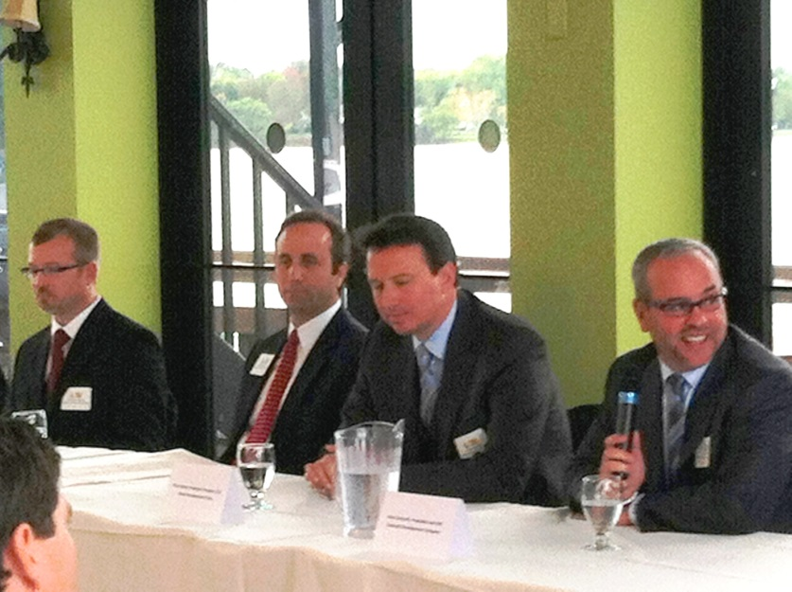
The premier commercial real estate organization in Buffalo
since 1986
Approximately 120 members and growing!
Owners and managers represent over 52m sq. ft. of commercial office space in WNY

Slide 5
Mission Statement
The Purpose of Greater Buffalo BOMA is to advance the professional ideals and
facilitate the concerns of the building owners, managers and associated professionals in
the Western New York area. In order to maximize our members’ ability to positively
affect the communities in which they operate, we will:
Provide NETWORKING opportunities to develop communication between members as well as access to industry professionals and decision makers
Support EDUCATIONAL programs including professional designation tracks that will enable each member to be a more effective and valuable manager.
Thoughtfully ADVOCATE on behalf of membership to foster the health and growth of our local industry thereby benefiting the community.
Conduct RESEARCH and provide data that assist members in reaching the business objectives of their individual companies and our industry as a whole.

Slide 6
2018 Board of Directors
Officers
  President Andrea Harvey, Parkland Professional Park, LLC
  1st V. President Michele Messina, TM Montante Development
  Secretary/ Treasure Jennifer Aiple
Directors
Joe Arlotta MJ Mechanical Services, Inc.
Jessica Boeckel Sinatra and Company
Chris Colvin Wendel Companies
Stacy Fonagy National Fuel Gas
Sarah Cudmore, Ciminelli Real Estate Corp.
Mary Houck, McGuire Development Co.
Emily McNulty, ServPro of the Southtowns
Zach Melas, Ciminelli Real Estate Corp.
Patrick Phillips, CPP, Allpro Parking, LLC
Immediate Past President Paul Muck Newmark Knight Frank
Executive Director Jennifer Aiple, MBA

Slide 7
Role of a Member
Members are our most valuable resource:
Participation – meetings, events, committee work
Contribution – time and talents
Influence the direction of the industry – education and advocacy
Getting Involved – ask not what BOMA can do for you…

Slide 8
How to Network at BOMA
PLACES TO NETWORK
Events and activities, serve on a committee
PLACES TO MARKET
Sponsor an event
Advertise in BOMA Buffalo newsletter
Advertise on website
Sponsor a luncheon or seminar
Event contributors and annual sponsorship opportunities

Slide 9

Education and Information
Certificate and Designation (RPA, FMA, SMT) Programs through BOMI
Advance notice and information on the latest legislative, regulatory and code issues
A variety of dynamic luncheon speakers on relevant topics
Building tours
Seminars (Vendor member and other professional training)

Slide 10
Getting the Most of your Membership
The BOMA Buffalo website www.bomabuffalo.com is a valuable tool.
Contact information for the local BOMA office, board members and committee information
Member only access to members directory
Upcoming events including all luncheons, tours and educational opportunities
Photos and handouts from meetings
GET INVOLVED!! JOIN A COMMITTEE TODAY!!

Slide 11
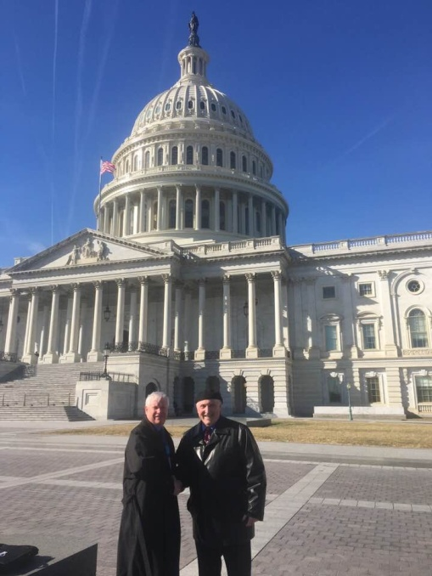
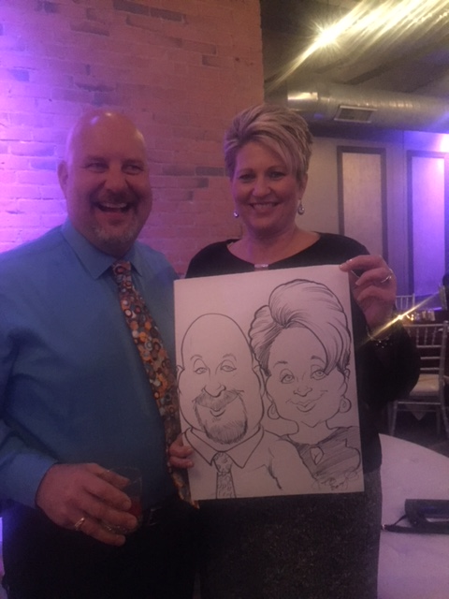
Committees
Government Affairs
BOMA Awards Program
Education
Golf Outing & Fundraiser
Holiday Celebration
Member Communications
Programs
Nominating Committee

Slide 12
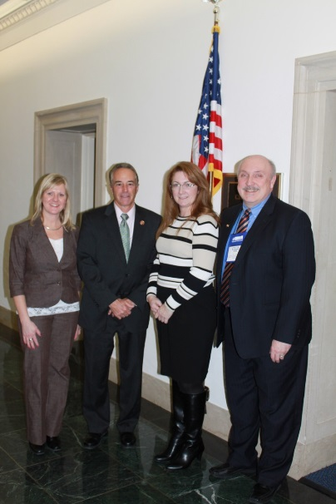
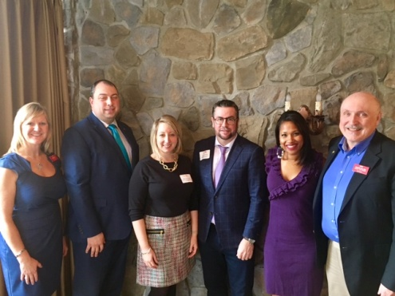
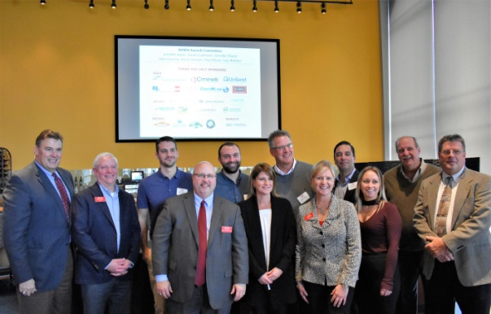
Events and Activities
Monthly events: 3rd Wednesday of each month (with exceptions)
Monthly Committee Meetings
Special Activities/Networking Events
Seminars and Classes
National Building Show & Expo (June) Winter Business Meeting (January) Regional Conference (April/May)

Slide 13
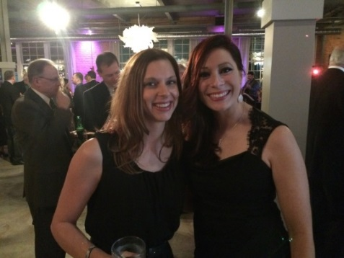
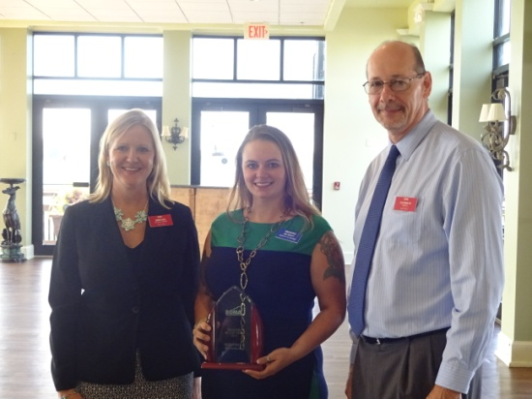

And more…
Holiday Party - evening with dinner and music (December)
Annual Awards Program/Luncheon (November)
Annual Golf Outing/Fundraiser (August)

Slide 14
BOMA Membership Committee
    Chair: Joe Arlotta, MJ Mechanical Services Inc..
    jarlotta@Mjmechanical.com
    Co chair: Zach Melas, Ciminelli Real Estate Corp.
    zmelas@ciminelli.com
    Jennifer Aiple, Executive Director, Greater Buffalo BOMA
    info@bomabuffalo.com
    Mike Farrell, ConstellationEnergy
    Mike.Farrell@constellation.com
    Kevin T. Hassen, Uniland Development Company
    khassen@uniland.com

Slide 15
Create your profile
BOMA Buffalo website: www.bomabuffalo.com
Username: your email address
Password: click on Forgot Password to setup your own
To access your payment history, update your profile, address, photo or company logo, register for meetings, access the BOMA Roster and more, go to www.bomabuffalo.com and click on Member Login-in on top of Home Page to view the member information menu.
BOMA International Website: www.boma.org
Your BOMA International ID:
Click on Sign In located in the upper right corner
Scroll down to Create Profile
If you have questions or need help with BOMA International’s website, please call 202-408-2662.
  Call Jennifer, BOMA Buffalo Executive Director if you need help. The BOMA Buffalo office hours
  are Tuesday, Wednesday and Thursday, 9:00 a.m. - 5:00 p.m.
  Office: (716) 856-3801, info@bomabuffalo.com

Slide 16
Questions?
Thank you for joining us today!

